Slide 1
Project Executive Summary
Team 1:
Aaron Ni, Xiangke Chen, Brian Nguyen, Ian Wong, Matthew Layne, Sam Lightfoot

Slide 2
Two potential topics
Recycling of Construction Materials
Spotify Integration
For the executive summary we will be focusing on the latter idea, though a final decision has not yet been reached.

Slide 3
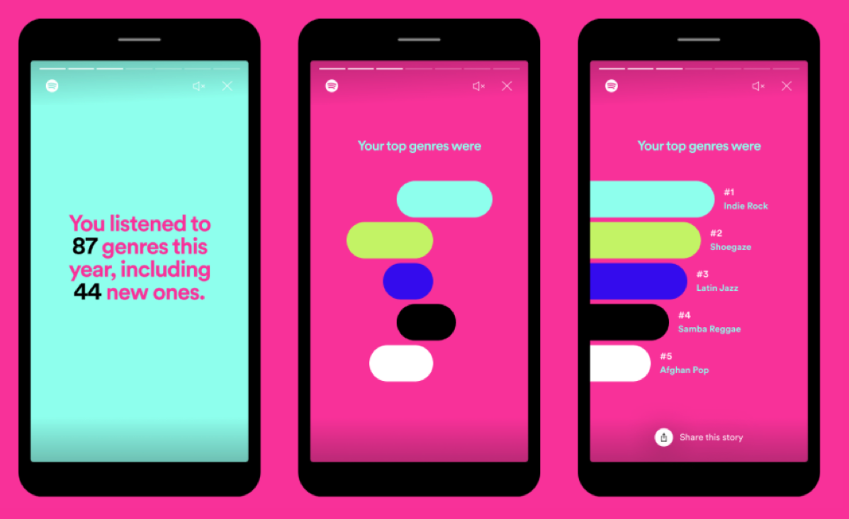
Problem Being Addressed
Spotify officially provides statistics once a year (Spotify Wrapped)
No great option for more consistent statistics
Third-party services exist, but requires routing user data
Unwanted permissions, e.g. altering a user’s playlists
Recieptify, Spotify Pie, Icebergify, etc.
Notes:
Currently, Spotify only officially provides listening statistics once per year, a service called Spotify Wrapped. This is great for yearly analysis, but what if users want to view their more recent favorite artists? Third-party applications do exist to access this data, but requires routing user data (e.g. emails, names, usernames) through a less secure system. Some of these apps also have permissions to alter playlists on a user’s account. Therefore, having a built-in page where users can view their listening activity at any time would be much more secure, convenient, and accessible.

Slide 4
Scope
Additional Services
Cater towards the recent interests of users
Front-end Work
Designing UI for data visualization
Filter Data
Filtering through an existing database of user data leveraging Spotify API
Classify User Data
Provide permissions to block or allow other users from viewing your data

Slide 5
Scope (cont’d)
Build Connections:
Subscription system to connect users to artists
Pull songs similar to those listened to by a user over a set period of time to build new playlists
Social Spotify ecosystem:
Integration of better social media practices
A more efficient and welcoming platform for cooperative activity, listening, and music sharing

Slide 6
Key Non-Functional Requirements
Performance
Page should load within 2 seconds
Playlist should be created without any downtime for the user
Security
Information should only be shared to permitted users
Novelty
Newer songs should be the preference in these playlists created by the recently-listened feature
Current recommendation system is already in place, but takes into account one’s entire listening experience, rather than localized times

Slide 7
Key Non-Functional Requirements (cont’d)
Quality of Life (General)
Compatible on iOS, Android, and online
The page should be easily navigable (e.g. through a navigation bar or by scrolling)
UI should be visually appealing
System should be logically integrated into the current systems already in place in the Spotify ecosystem

Slide 8
Key Systems
Artist Subscription System
Leverage connections to recently-released entries from artists
User Information Database (accessed through Spotify API)
Gather data to analyze
Spotify Front End
Add functionality like buttons and other UI details to configure and launch the recency functionality

Slide 9
Stakeholders
Users
Benefit from being able to easily connect with their friends and favorite artists
Benefit from a more secure way to view their listening activity
Spotify
Benefit from users spending more time on their app
Artists
Benefit from easily connecting with fans (e.g. announcing concert dates and upcoming releases)

Slide 10
Summary of Sprint Results
Trello Board set up and all members added
Project narrowed to two topics
Spotify more explored than the alternative
Document workspace set up
Discord Server set up for Team communication
All members contacted and on Discord Server

Slide 11
Blockers
Need to decide between Spotify and Contractor systems
Most likely will go with Spotify integration system
Need a more standard time to meet and work on project

Slide 12
Sprint 2 Tasks
Determine exact topic choice
Also Determine Project / Team Name
Catch up all members to current status
Establish ITAA basics
Create Backlog tasks and determine priority

Slide 13
Links
Trello Board
IBM ITAA Project
If the above fails, try this link
Google Doc
Discord

